Slide 1
Vinny Sakore
Vinny Sakore is the Chief Technology Officer for NetDiligence®, a Cyber Risk Management company.
Former HIPAA Security Officer for Verizon
Mr. Sakore speaks nationally and internationally on topics ranging from Cyber Risk, Mobile Threats, Cloud Security, and HIPAA Security.
Linked-In:https://www.linkedin.com/in/vinnysakore/
Twitter: @VinnySakore

Slide 2
About NetDiligence®
Sampling of insurers that we support:
Aegis
AIG
Allianz
Arch
Argo
Aspen
Axis
Barbican
Beazley
Berkley
Berkshire Hathaway
Brit
Chubb
Cuna Mutual
DMI
Endurance
Hiscox
HSB
Ironshore
Kiln
Liberty
Markel
National League of Cities
One Beacon
Philadelphia
Principia
QBE
RLI
Starr
Swiss RE
Travelers
Trans Re
USLI
Vela
XL
Zurich
15+ years supporting the cyber liability insurance industry.
For loss control service, we support the majority of cyber liability insurance markets.
We conduct cyber risk assessments on organizations – and their vendors – all sizes & sectors.
We build/ host Breach Response Plans
We also support most (60+) cyber risk insurers – and their insured clients – with post data breach crisis support via eRisk Hub
We also host four Cyber Risk and Privacy conferences annually. They are located in London, Philadelphia, Santa Monica and Toronto.

Slide 3
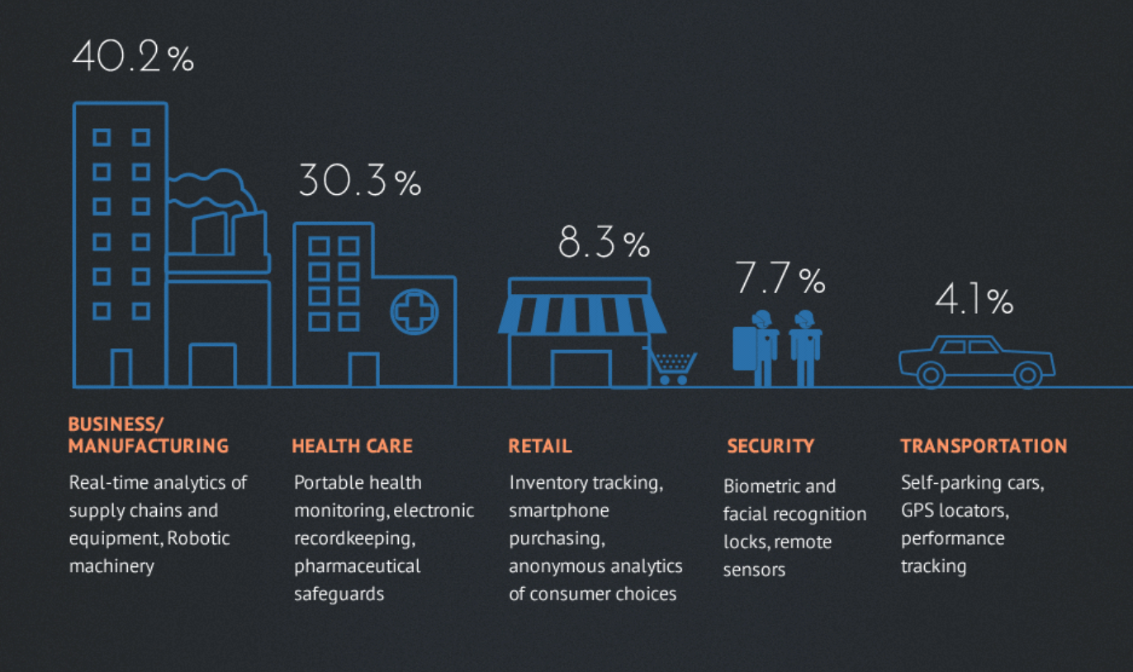
How Real is the Threat to the Energy Sector
“multi-stage intrusion campaign by Russian government cyber actors where they staged malware, conducted spear phishing, and gain remote access into energy sector networks.
- Department of Homeland Security and the FBI
Source: 2016 SANS Study on Cyber Threat Intelligence

Slide 4
NetDiligence® 2017 Cyber Claims Study
Claims Submitted: 2,411
Per Breach Costs (N=570)
3-Year Average Breach Cost: $394K Comment: More representative of ‘Main Street’, avg. lowered this year by increased
population of SME @ 87%.
2016 1-Year Average: $665K
Large Company: $3.2M
Per-Record Costs (N=313)
2014-2017 Average Per-Record Cost: $8K (median $46)
Cost Range: $0.02-$1.6M

Slide 5
NetDiligence® 2017 Cyber Claims Study
Crisis Services Costs (forensics, legal counsel, notification, ID/credit monitoring, etc.)
2014-17 Average Cost of Crisis Services: $249K
2016 Average Cost of Crisis Services: $357K
Legal Costs (defense & settlement)
Average Cost of Legal Defense: $121K
Average Cost of Regulatory Defense: $696K
Average Cost of Settlement: $255K
3 yr avg

Slide 6
NetDiligence® 2017 Cyber Claims Study
Phishing (N=46)*
Average Breach Cost: $181K
Ransomware (N=60)
Average breach cost: $61K
PhishFight®
See in eRiskHub®
*Phishing includes Phishing, BEC and Wire Transfer Fraud

Slide 7
NetDiligence® 2017 Cyber Claims Study
“Breach-less” Claims
Denial of Service (DDoS)
Breach Response Average claim: $259K
BI/Revenue Loss Average: $27K
Total Breach Cost Average: $411K
Wire Transfer Fraud
Average Payout Loss: $180K

Slide 8
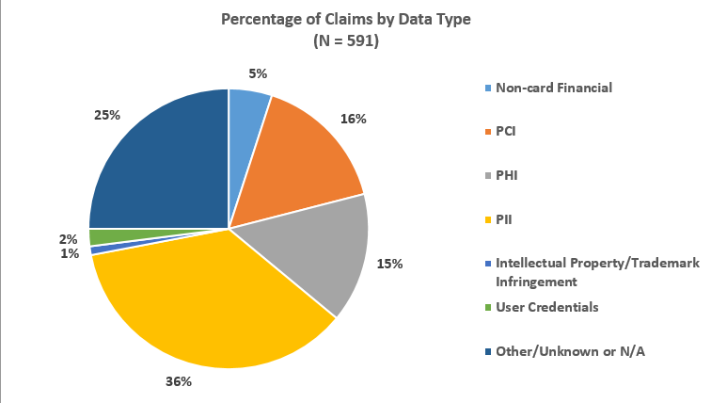
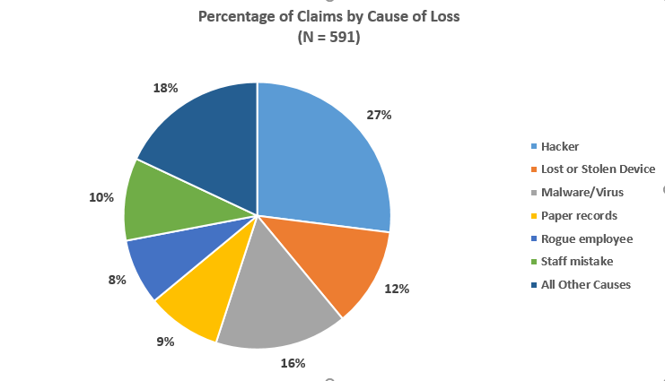
NetDiligence® 2017 Cyber Claims Study
PII
Hacker

Slide 9
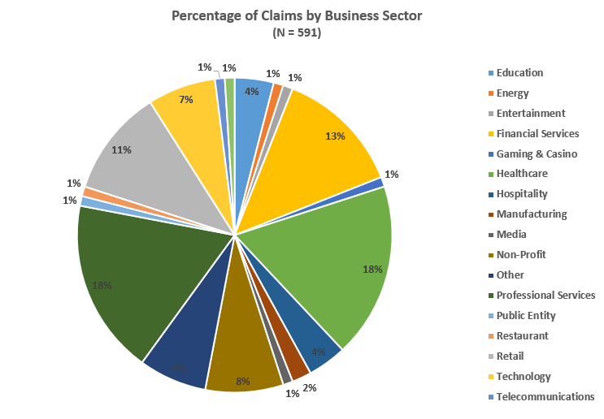
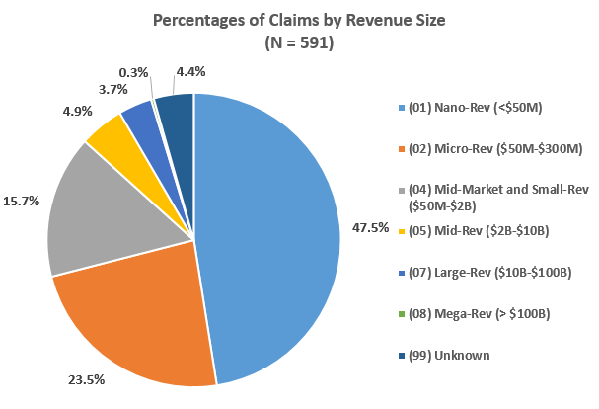
NetDiligence® 2017 Cyber Claims Study
SMEs approx. 87%
Prof Services
Health

Slide 10
Trends Driving Risk Assessment and Breach Planning
Compliance – HIPAA, DFS and other regulations are driving the need for having an accessible, documented risk assessment and breach response plan
Risk Management - Having an active risk management program and an actionable breach response plan at your finger tips or a moments notice is critical
Insurance Requirement -- Many leading cyber liability insurance carriers request/require clients to have risk assessments and a breach response plan
Partner / Supplier Requirements – Certain business partners they are more often requiring a data breach plan

Slide 11
DR/IR TIPS FROM NETDILIGENCE®
TIP 1: Build an Internal Incident Response Team (IRT)
Executive Management
Compliance, Legal, Privacy & Insurance Risk Management
Finance & Audit
Human Resources & Customer Service
Information Technology (IT) & Information Security
Marketing & Public Relations
Do they even know that they are part of the team?

Slide 12
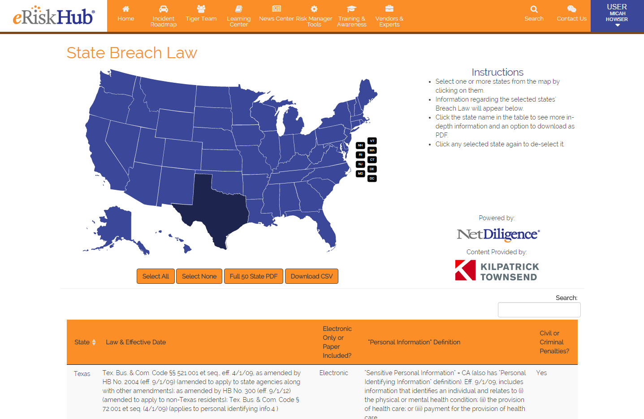
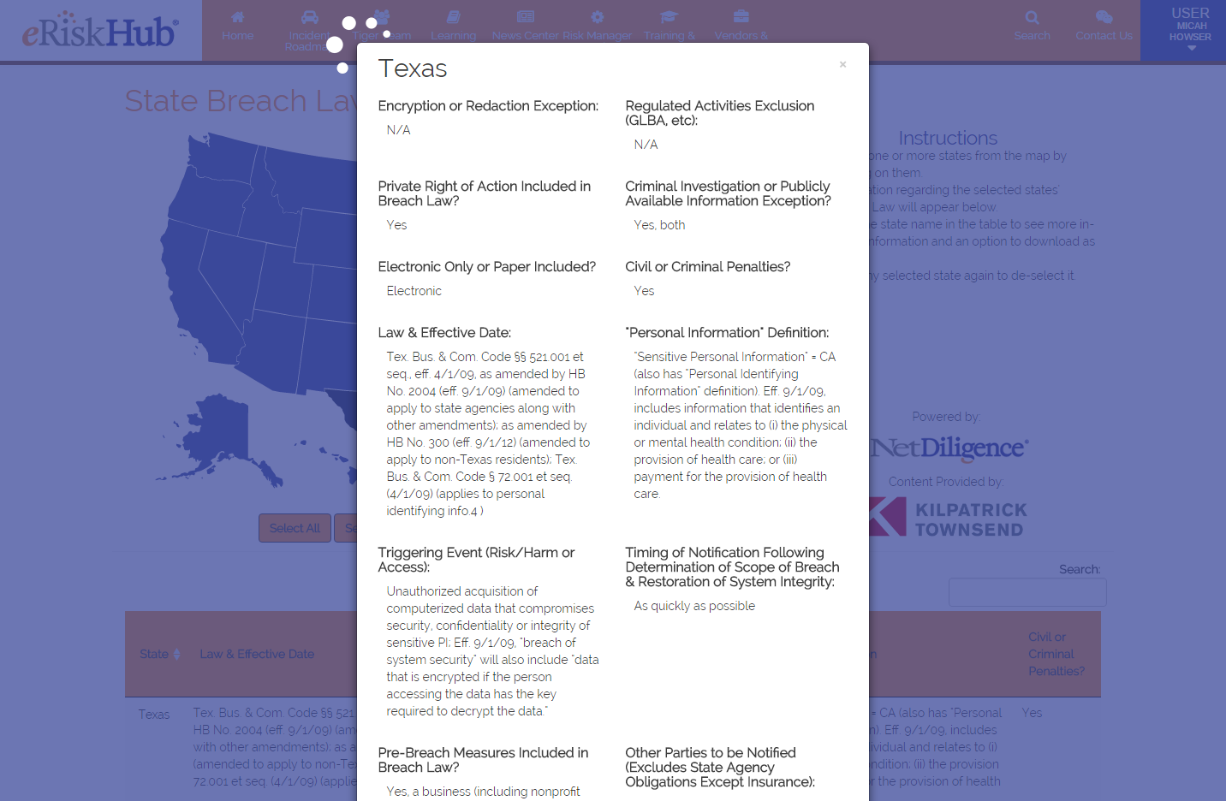
TIP 2: Ensure Your Plan is Reviewed by Counsel
DFS, HIPAA, SOX, GDPR?

Slide 13
TIP 3: Ensure Your Plan is Accessible and Actionable
A twenty page document is NOT actionable?
Who is the first call?
Is there a checklist of key action items?
Who are our experts to engage for help? Breach Coach® lawyer for hands-on guidance, as well as experts such as computer forensic investigators.

Slide 14
Thank you!
Vinny Sakore NetDiligence®
Vinny.Sakore@NetDiligence.com

